Slide 1
Intrusion Detection System in Networks Employing a Double-Layer Architecture Using Machine Learning Algorithms
Presented By:
Amrit Mohapatra
Natasha Jain
Under the Guidance of
Dr. Bhawna Rudra

Slide 2
INTRODUCTION
In recent years, Intrusion Detection System (IDS) increasingly plays a vital role in discovering malicious activities due to a massive expansion of network-connected IT devices around the world.
The key challenge in building an efficient IDS is the selection of relevant features in the case of multiple attack categories.
Furthermore, the large volume of network traffic generated by modern networks makes it difficult for traditional intrusion detection systems to keep up.
A hybrid approach, in general, refers to a method that combines two or more learning techniques e.g., using a signature-based method with an anomaly-based method, or an anomaly-based method with an anomaly-based method.

Slide 3
PROBLEM STATEMENT
To develop a double layered Machine learning hybrid approach, that combines two different machine learning techniques to improve the accuracy and efficiency of intrusion detection systems,while keeping false alarms to a minimum.

Slide 4
LITERATURE SURVEY
TABLE 1.
Literature Survey
Authors | Year | Proposed Method | Feature Selection | Algorithm and Evaluation Criteria
Liu et al | 2021 | Proposed a hybrid IDS Random Forest, and CNN+LSTM for anomaly classification | Attribute Ratio | Kmeans, RF and CNN+LSTM Accuracy TPR
Golrang et al | 2020 | Proposed a hybrid multi-objective approach to address the redundant feature selection issue | NSGAII-ANN | Random Forest Accuracy, F1 score, Precision
Tama et al | 2019 | Proposed a stagc meta classifier with majority voting and hybrid feature selection | PSO+ACO+GA | Rotating Forest and Bagging Precision, Detection Rate,FAR
Yao el al. | 2019 | Proposed HMLD using hybrid feature selection and hybrid classification | FM IFS | SVM,ANN Accuracy, F1 score,

Slide 5
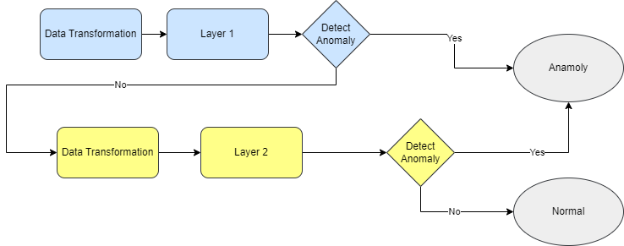
METHODOLOGY
Fig1. Flow Chart of proposed model

Slide 6
DATASET
The dataset consists of a wide variety of intrusions simulated in a military network environment. They created an environment to acquire raw TCP/IP dump data for a network by simulating a typical US Air Force LAN. Also, each connection is labelled as either normal or as an attack with exactly one specific attack type. Each connection record consists of about 100 bytes.
For each TCP/IP connection, 41 quantitative and qualitative features are obtained from normal and attack data (3 qualitative and 38 quantitative features) .The class variable has two categories:
Normal
Anomalous
Link: https://www.kaggle.com/datasets/sampadab17/network-intrusion-detection

Slide 7
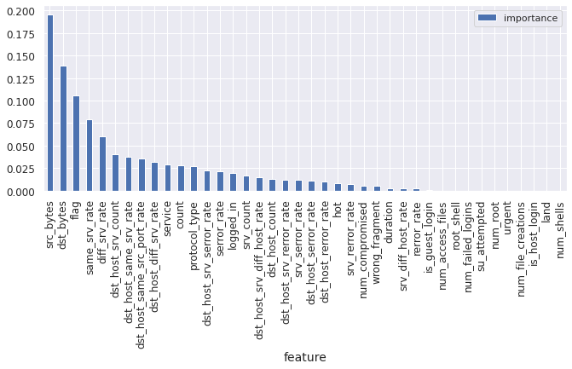
FEATURE SELECTION
Fig2. Importance Graph of Features

Slide 8
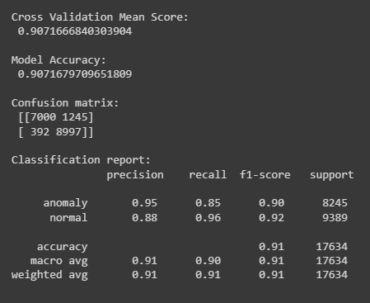
OBSERVATIONS
Report for the non hybrid models are as follows:
Fig3. Results of Naive bayes model

Slide 9
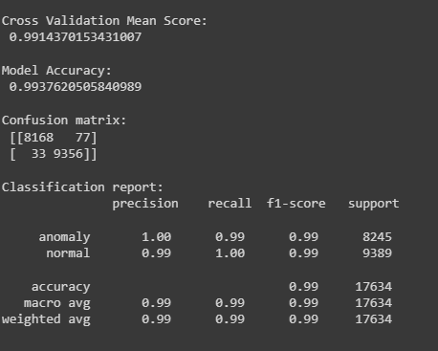
OBSERVATIONS
Report for the non hybrid models are as follows:
Fig4. Results of K Nearest Neighbors Classifier Model

Slide 10
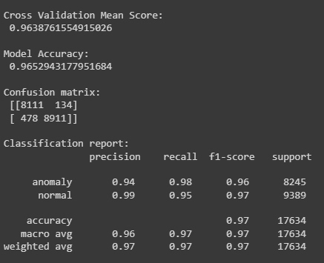
OBSERVATIONS
Report for the non hybrid models are as follows:
Fig5. Results of XGBoost Classifier Model

Slide 11
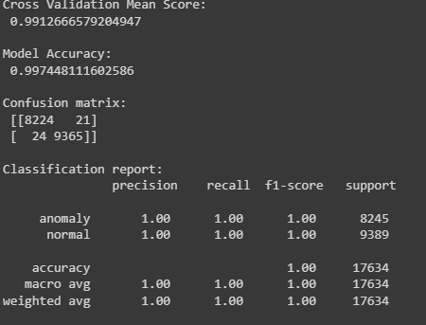
OBSERVATIONS
Report for the non hybrid models are as follows:
Fig6.Results of Random Forest Classifier Model

Slide 12
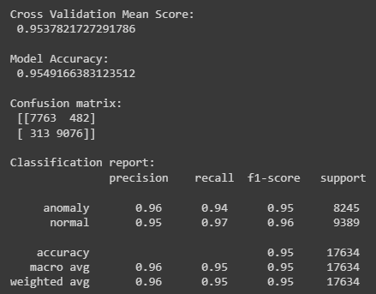
OBSERVATIONS
Report for the non hybrid models are as follows:
Fig7. Results of Logistic Regression Model

Slide 13
OBSERVATIONS
Results for hybrid models
TABLE 2.
Experiment results of Linear Regression and Decision Tree double layered model.
Models Evaluation Metrics | Traditional (Linear Regression) | Proposed method (Linear Regression and Decision Tree)
Accuracy | 95.50 | 99.76
Misclassification | 4.49 | 0.23
Precision | 96.00 | 99.74
Sensitivity | 94.16 | 99.74
Specificity | 96.25 | 99.77

Slide 14
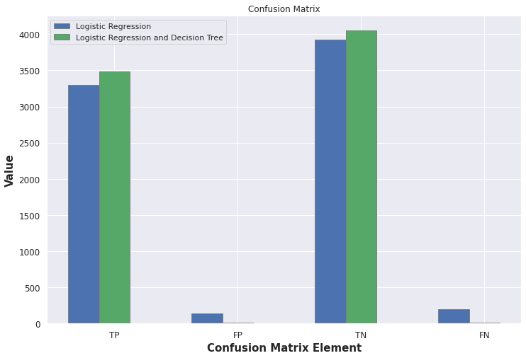
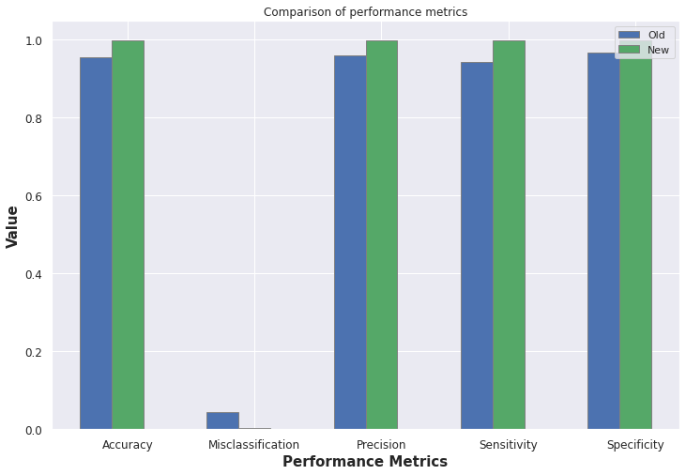
OBSERVATIONS
Results for hybrid models
Fig9. Performance metrics of Linear Regression and Decision Tree

Slide 15
OBSERVATIONS
Results for hybrid models
TABLE 3
Experiment results of Naïve bayes and decision Tree double layered model.
Models Evaluation Metrics | Traditional (Naïve bayes) | Proposed method (Naïve bayes and decision Tree)
Accuracy | 90.67 | 99.70
Misclassification | 9.32 | 0.29
Precision | 94.06 | 99.62
Sensitivity | 85.22 | 99.74
Specificity | 95.36 | 99.67

Slide 16
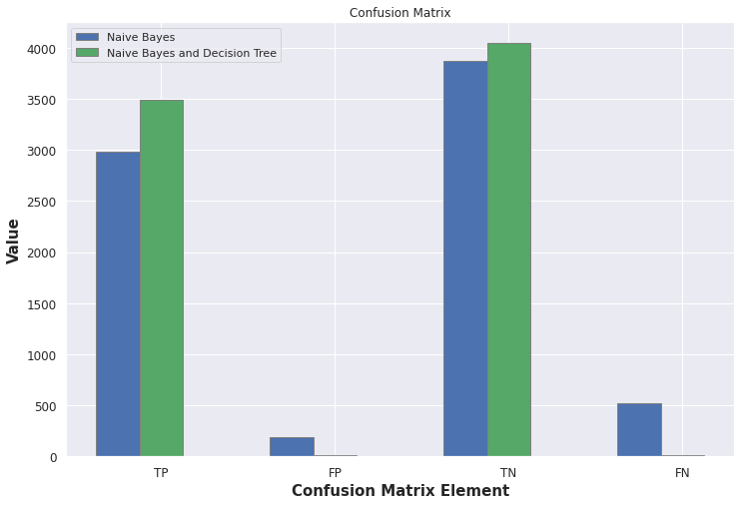
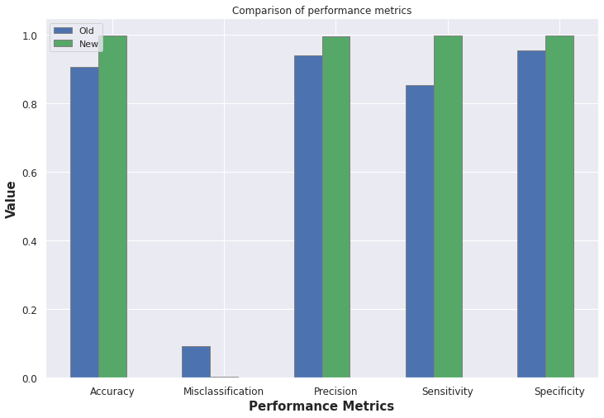
OBSERVATIONS
Results for hybrid models
Fig10. Performance metrics of Naive bayes and Decision Tree

Slide 17
OBSERVATIONS
Results for hybrid models
TABLE 4
Experiment results of Linear Regression and XGBoost double layered model.
Models Evaluation Metrics | Traditional (Linear Regression) | Proposed method (Linear Regression and XGBoost)
Accuracy | 95.50 | 98.74
Misclassification | 4.49 | 1.25
Precision | 96.00 | 98.24
Sensitivity | 94.19 | 99.05
Specificity | 96.62 | 98.47

Slide 18


OBSERVATIONS
Results for hybrid models
Fig11. Performance metrics of Linear Regression and XGBoost

Slide 19
OBSERVATIONS
Results for hybrid models
TABLE 5.
Experiment results of . Decision Tree and XGBoost double layered model.
Models Evaluation Metrics | Traditional (Decision Tree) | Proposed method (Decision Tree and XGBoost)
Accuracy | 99.47 | 99.72
Misclassification | 0.05 | 0.02
Precision | 99.28 | 99.54
Sensitivity | 99.57 | 99.85
Specificity | 99.38 | 99.60

Slide 20
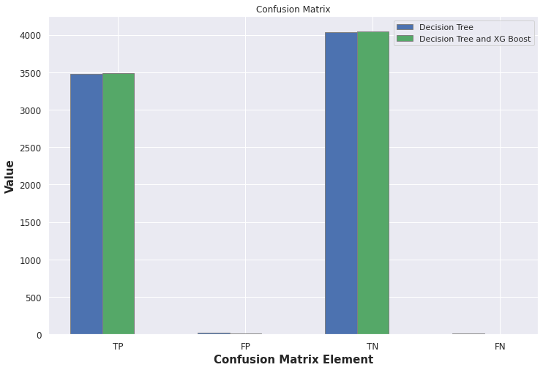
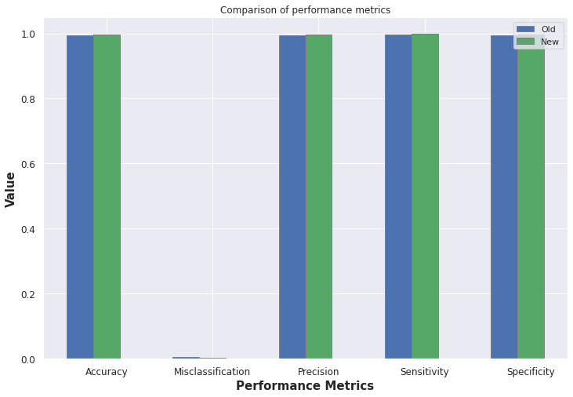
OBSERVATIONS
Results for hybrid models
Fig12. Performance metrics of Decision Tree and XGBoost

Slide 21
CONCLUSION AND FUTURE WORK
In conclusion, the double-layered hybrid approach for Network Intrusion Detection System presented shows promising results in effectively detecting network intrusion.
By combining Naive Bayes, Logistic Regression, and Decision Tree models, the hybrid approach takes advantage of the strengths of each model and overcomes their limitations.
The approach was tested on a benchmark dataset and achieved high accuracy, precision, recall, and F1-score.
This double-layered hybrid approach can be further improved by incorporating other machine learning algorithms or techniques and testing it on larger datasets.
Future area of research will be to develop dynamic feature selection algorithms that adaptively select the most relevant features for intrusion detection in real-time, based on the current network traffic and attack patterns.
Focus will be on developing algorithms that can handle large-scale networks and high-speed traffic without sacrificing accuracy. We will also investigate the use of adversarial attacks to evaluate the robustness of intrusion detection systems.
Nonetheless, the presented approach is a significant step towards building an effective and efficient network intrusion detection system that can help prevent cyber attacks and safeguard critical data and systems.

Slide 22
REFERENCES
[1]. C. Liu, Z. Gu, and J. Wang, ‘‘A hybrid intrusion detection system based on scalable K-means+ random forest and deep learning,’’ IEEE Access, vol. 9, pp. 75729–75740, 2021.
https://ieeexplore.ieee.org/document/9437227
[2]. A. Golrang, A. M. Golrang, S. Yildirim Yayilgan, and O. Elezaj, ‘‘A novel hybrid IDS based on modified NSGAII-ANN and random forest,’’ Electronics, vol. 9, no. 4, p. 577, Mar. 2020
https://www.mdpi.com/2079-9292/9/4/577
[3]. B. A. Tama, M. Comuzzi, and K. Rhee, ‘‘TSE-IDS: A two-stage classifier ensemble for intelligent anomaly-based intrusion detection system,’’ IEEE Access, vol. 7, pp. 94497–94507, 2019.
https://ieeexplore.ieee.org/stamp/stamp.jsp?arnumber=8759867
[4]. H. Yao, Q. Wang, L. Wang, P. Zhang, M. Li, and Y. Liu, ‘‘An intrusion detection framework based on hybrid multi-level data mining,’’ Int. J.Parallel Program., vol. 47, no. 4, pp. 740–758, Aug. 2019.
https://bura.brunel.ac.uk/bitstream/2438/17745/2/FullText.pdf
[5]. T. Wisanwanichthan and M. Thammawichai, "A Double-Layered Hybrid Approach for Network Intrusion Detection System Using Combined Naive Bayes and SVM," in IEEE Access, vol. 9, pp. 138432-138450, 2021, doi: 10.1109/ACCESS.2021.3118573.
https://ieeexplore.ieee.org/document/9562534

Slide 23
THANK YOU

